Slide 1
Statistical Analysis of Campus Recruitments

Slide 2
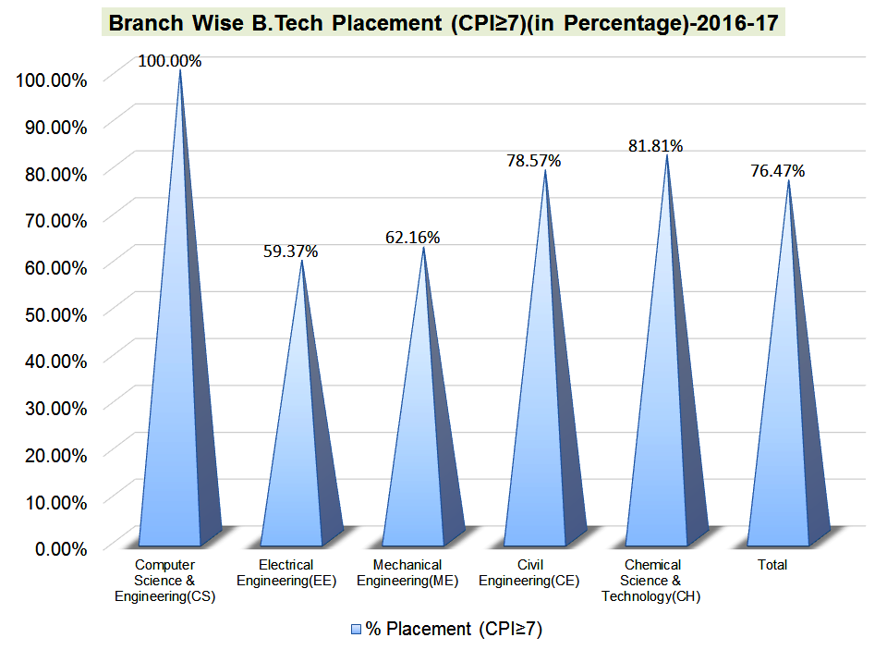
Mentor: JAYAVIBHAVA
Group Members:
Divyashree N
Harshavardhan Reddy B
Payal M
Pooja K
Venkatesh R
Vijayprasath S

Slide 3
INTRODUCTION
These days every single organization is going to the universities and selecting the students.
Each organization has its own particular criteria, similar to scholarly outcomes and different exercises.
In light of the criteria the students are shortlisted and are being put in that specific organization.
There are many organizations who conducts surveys on the universities and declare the outcomes based on the number of students selected for that organization.

Slide 4
SCOPE OF THE PROJECT
Number of Colleges Visited Per Quarter.
Student Placement Percentage Per Year.
Year Wise Total number of Students Selected.
Companies with criteria and their packages.

Slide 5





SYSTEM REQUIREMENTS

Slide 6
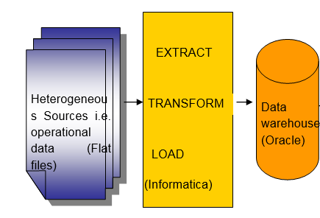
PROJECT FLOW

Slide 7
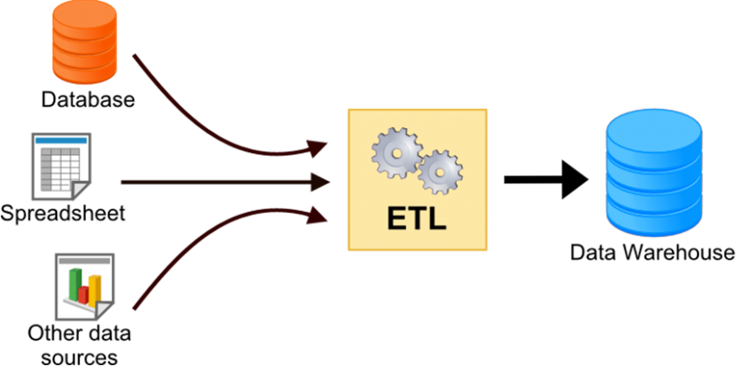
CONCEPT OF ETL
The process of extracting data from source systems and bringing it into the data warehouse is commonly called ETL, which stands for Extraction, Transformation, and Loading.

Slide 8
CONCEPT OF ETL
Extract is the process of reading data from a database. In this stage, the data is collected, often from multiple and different types of sources.
Transform is the process of converting the extracted data from its previous form into the form it needs to be in, so that it can be placed into another database.
Load is the process of writing the data into the target database.

Slide 9
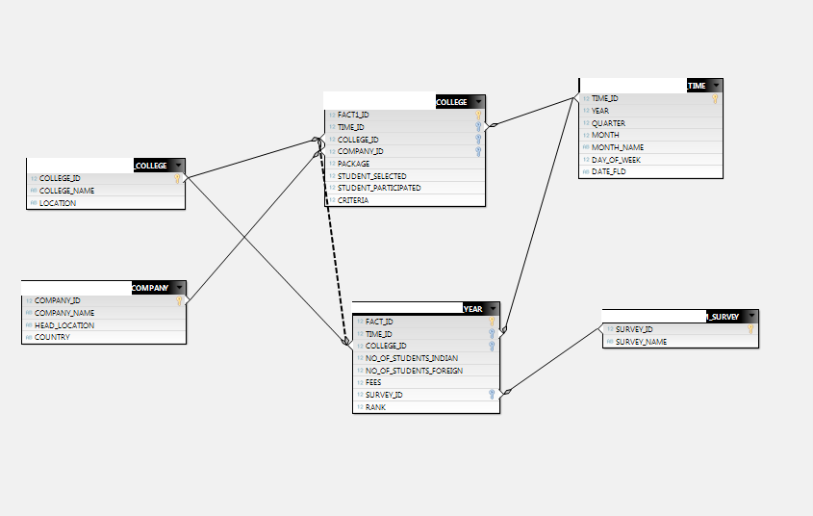
STAR SCHEMA
The star schema is the simplest style of data mart schema.
The star schema consists of one or more fact tables referencing any number of dimension tables.

Slide 10
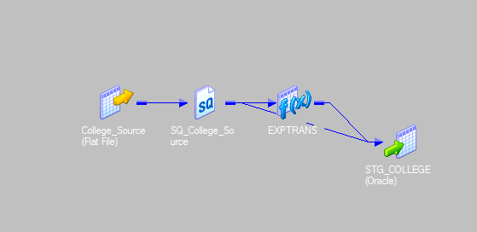


MAPPING
Staging Table: STG_COLLEGE

Slide 11
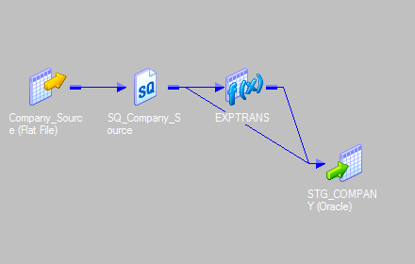


MAPPING CONTD..
Staging Table: STG_COMPANY

Slide 12
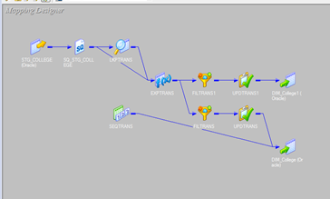




Dimensional Table: Dim_College

Slide 13
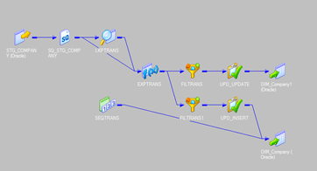
MAPPING
Dimensional Table: Dim_Company

Slide 14
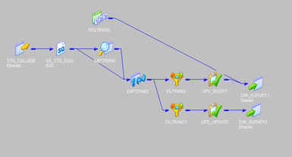
MAPPING
Dimensional Table: Dim_Survey

Slide 15
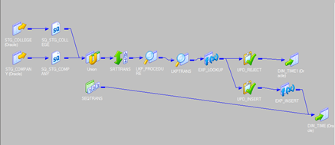



MAPPING
Dimensional Table: Dim_Date

Slide 16
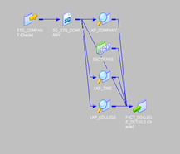

MAPPING
Fact Table: Fact_College_Details

Slide 17
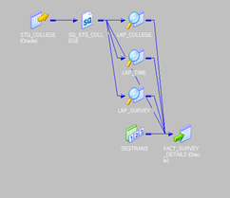

MAPPING
Fact Table: Fact_Survey_Details

Slide 18


Slide 19


